Slide 1
Analysis of User Transactions
-Shivam Parab

Slide 2
MetaData
items : items redeemed in each redemption order
k_user_id : all the merchants ids
user_id : all the users id
paid_amount: transaction value for the redemption
paid_at: epoch timestamp at which a person transferred an amount
redeemed_at : epoch timestamp at which a person redeemed an item

Slide 3
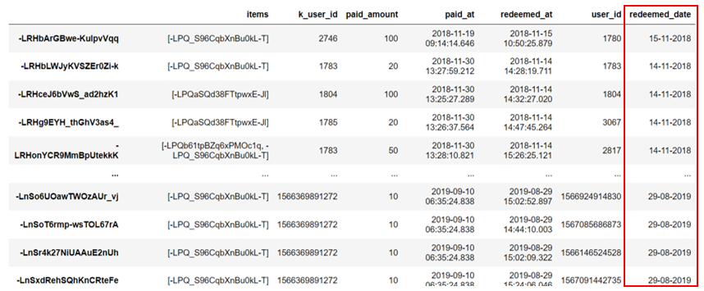
Data Processing
Converting the epoch timestamp of each redemption to a proper Date format (dd-mm-yyyy)

Slide 4
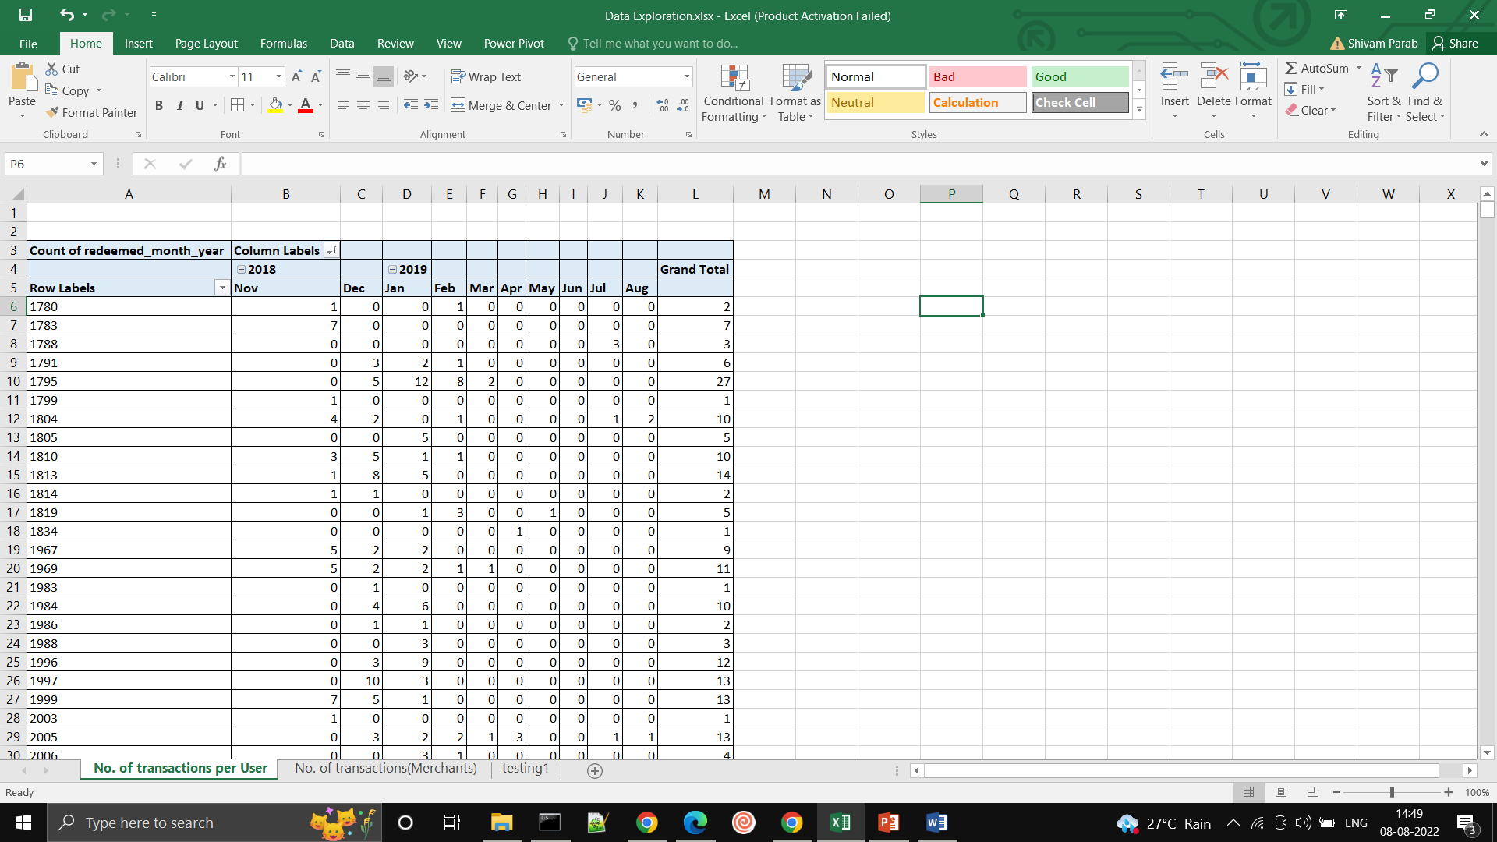
Creating an overview of No. of transactions per User for the period between Nov 2018 to September 2019.

Slide 5
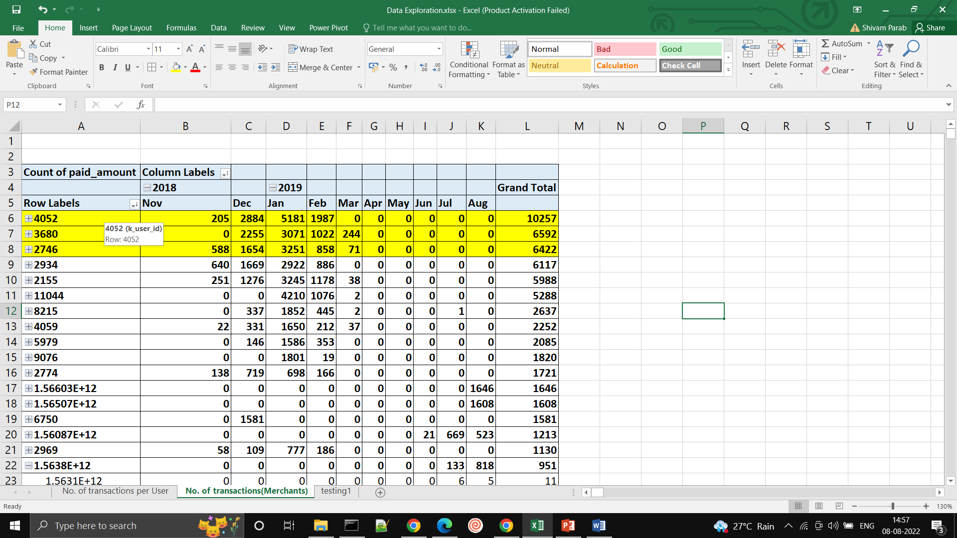
Create a mapping for at least 3 Merchants or K_users showing the number of Transactions that are done by each merchant for the 10 months period in total

Slide 6
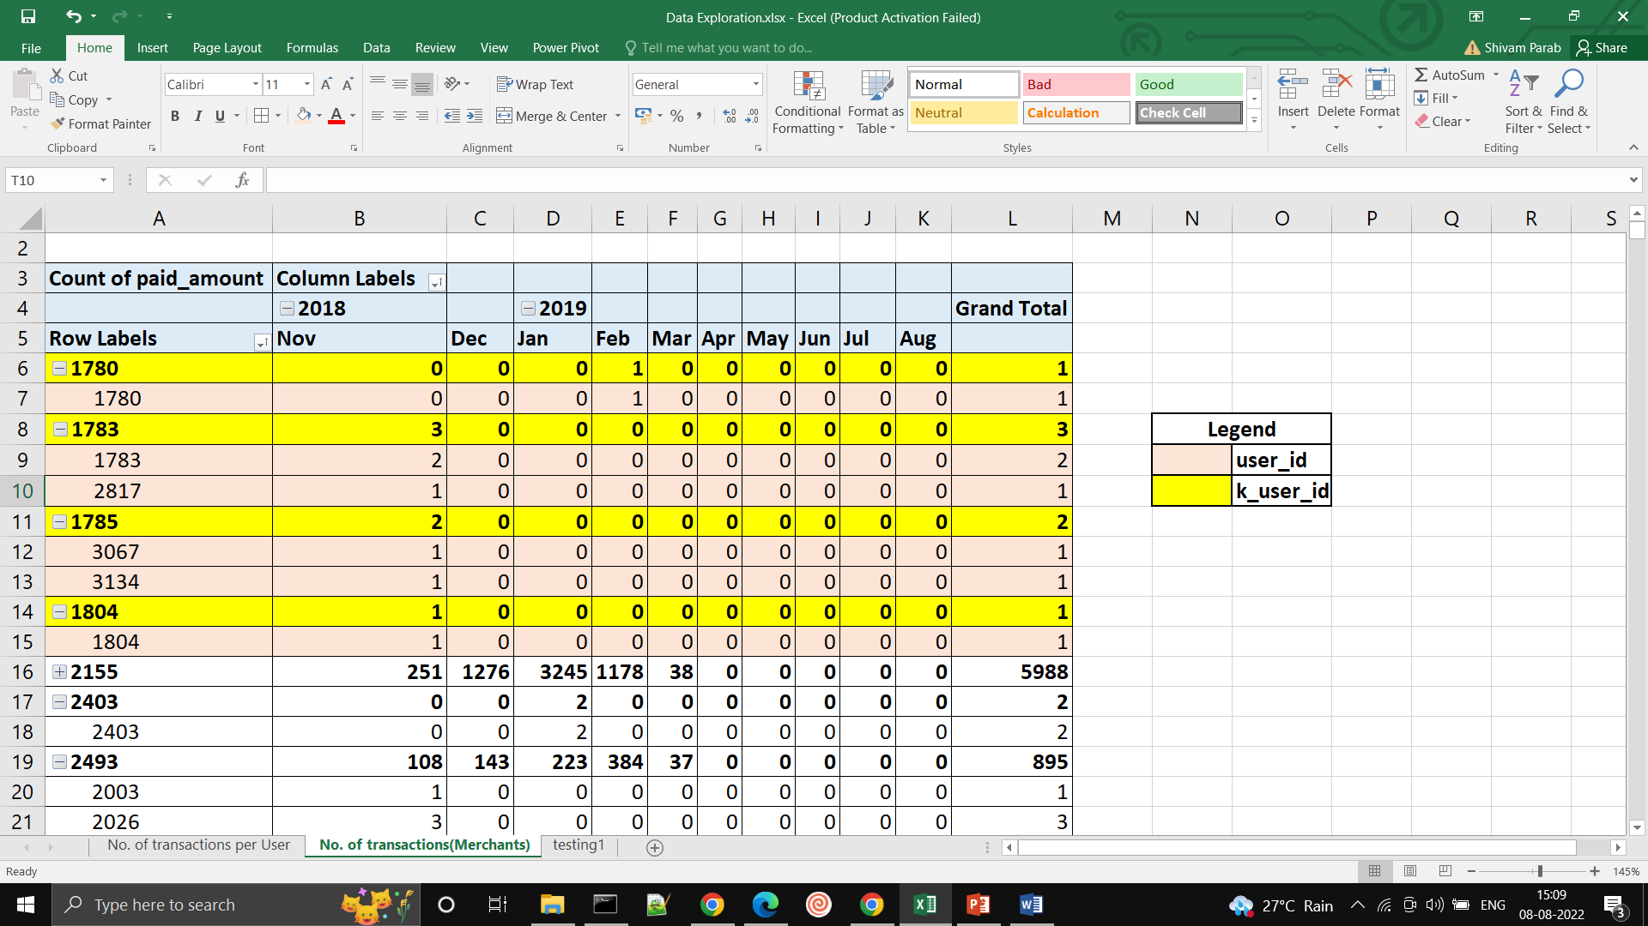
Create a mapping for at least 3 Merchants or K_users showing the number of Users who utilized the ‘Merchant or K_user’ service in the 10 months period

Slide 7
Data Analysis
Number of Transactions per User Month-wise:
The number of transactions per User for period of 10 month is shown here.
We can see that there are large amount of transactions in November-December-January months.
So we have to increase the sales concentrating on these months.
We can start a campaign to increase the sales in November to maximize the transactions in following months.

Slide 8
Top 5 Merchant that Users Use Month-wise:
The Top 5 MVP Merchant sales for period of 10 month is shown here.
We can see that there are large amount of transactions in November-December-January-February months with January having most transactions.
Merchant 4052 has Highest amount of Transactions.
We have to concentrate to increase the transactions between March to August. We can use these merchants to increase the number of Transactions during those months.

